Slide 1

🏆 Dynamic Player Transfer Value Prediction
Using AI and Multi-source Data to unlock advanced financial and strategic insights in professional football.
A comprehensive machine learning system for predicting football player transfer values using advanced feature engineering, sentiment analysis, and ensemble modeling techniques.
📊 Key Development Statistics
800+
2.4K+
74K+
Engineered Features
Player Records
Social Media Posts
Capturing performance and market complexity.
Historical data for robust training.
Data leveraged for sentiment analysis.
4
ML Models Combined
Stacked ensemble for maximum accuracy.

Slide 2


🎯 The Challenge: Financial Risk in Football Transfers
Market Volatility
Values fluctuate dramatically based on performance spikes, unexpected injuries, contract disputes, and rapidly shifting market sentiment, making manual valuation unreliable.
Multi-factor Dependencies
True value is a complex function of on-field statistics, age profile, contract status, injury history, and public perception metrics, which traditional models struggle to synthesize.
Significant Financial Impact
An incorrect valuation—even by a margin of 5-10%—can cost clubs millions in overpaid transfer fees or lost revenue opportunities.
Data Complexity
Traditional methods rely too heavily on basic performance stats and fail to capture the full spectrum of qualitative and temporal influencing factors.
Our Solution: An AI-powered system that combines multiple data sources, advanced feature engineering, sentiment analysis, and ensemble machine learning to deliver objective and accurate transfer value predictions.

Slide 3
📅 Project Development Timeline (8 Weeks)
A rigorous, eight-week sprint focused on rapid iteration and deployment of a production-ready model.
Week 1: Data Collection & EDA
1
Collected multi-source data (performance, market, sentiment, injury) and began exploratory data analysis to identify initial trends and gaps.
2
Week 2: Data Preprocessing
Implemented robust cleaning, normalization, and established the foundational feature engineering framework for structured and unstructured data.
Weeks 3–4: Advanced Feature Engineering
3
Created and validated over 800 features. Integrated sentiment analysis module from 74,000+ social media posts.
4
Week 5: LSTM Time Series Modeling
Implemented Long Short-Term Memory (LSTM) architecture specifically to capture temporal patterns and future forecasting elements of player value trends.
Week 6: Ensemble Modeling
5
Developed the Stacked Ensemble: combining predictions from XGBoost, LightGBM, and the LSTM models for superior predictive stability.
6
Week 7: Model Evaluation & Tuning
Optimized hyperparameters based on minimizing Root Mean Squared Error (RMSE) and Mean Absolute Error (MAE), maximizing R² across validation sets.
Week 8: Deployment & Application
7
Finalized model artifacts and deployed the Streamlit web application, enabling immediate, real-time prediction capabilities.

Slide 4



📊 Data Sources & Advanced Feature Engineering
Moving beyond simple metrics: creating predictive power through multi-source integration and deep feature creation.
Multi-Source Data Integration
Advanced Feature Engineering (800+)
Performance Data
Performance Trends
On-field stats, positional metrics, and role effectiveness.
Rolling averages, Exponential Moving Averages (EMAs), and Year-over-Year changes to capture momentum.
Injury Records
Historical injury frequency, severity, and recovery time analysis.
Injury Analysis
Predictive risk scores and severity percentages based on past incidents and time missed.
Social Media Sentiment
Public perception, media mentions, and fan engagement.
Career Stage Features
Market Data
Rookie/veteran flags and indicators pinpointing potential peak value age ranges.
Contract expiry dates, league transfer indices, and club financial health indicators.
Sentiment Features
Quantified sentiment scores, trend analysis, and volatility measures derived from text data.

Slide 5


🤖 Machine Learning Architecture: The Ensemble Approach
Utilizing a multi-model pipeline to ensure robustness and leverage the strengths of different predictive methods.
Data Collection
Preprocessing
Feature Engineering
Model Training
Model Comparison and Rationale
XGBoost
Exceptional at handling complex, non-linear feature interactions and high-dimensional sparse data.
LightGBM
A fast and highly efficient gradient boosting framework, used for rapid feature selection and predictive power.
LSTM (Time Series)
Critical for capturing temporal dependencies and forecasting future value trajectories based on sequential data.
Stacked Ensemble
The final layer combines outputs from the base models, mitigating individual biases and achieving the best overall performance.

Slide 6
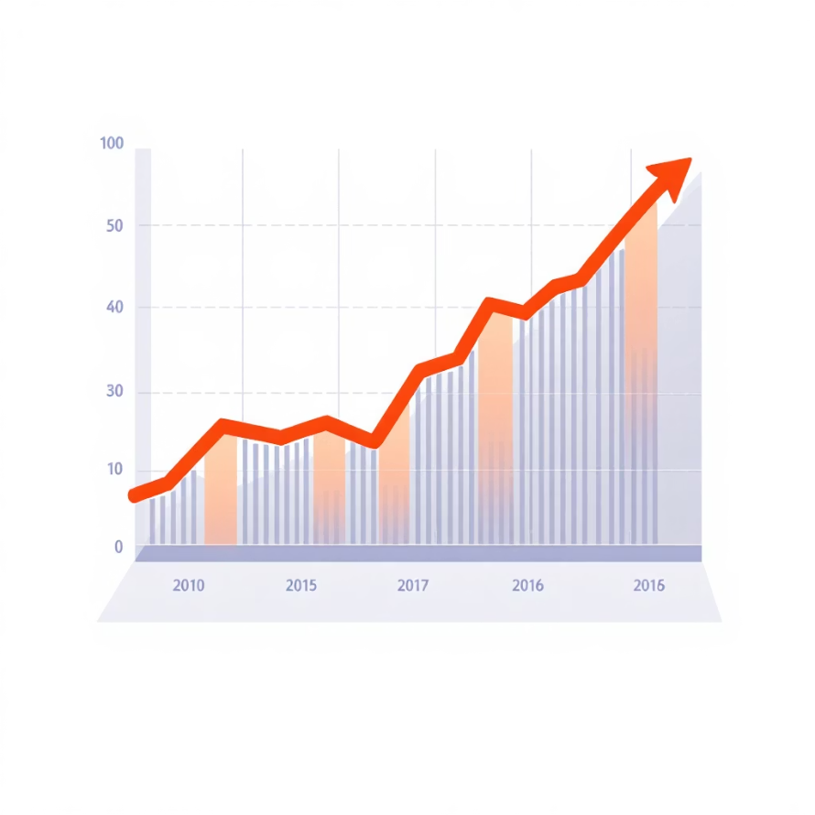






📈 Results & Performance Metrics
The Stacked Ensemble model demonstrates superior predictive accuracy crucial for high-stakes financial decisions.
Key Achievements
Our rigorous development and testing phase culminated in a highly effective final model:
Best Model: Stacked Ensemble
Input Size: 800+ Features
Data Volume: 2,400+ Player Records
Sentiment Data: 74,000+ Posts Analyzed
Strategic Impact
Accurate Predictions
Provides reliable and defensible transfer value estimations, minimizing overpayment risk.
Comprehensive Analysis
The multi-source integration offers a holistic view of player value, beyond simple statistical output.

Slide 7

💻 Interactive Web Application: Streamlit Dashboard
Providing club analysts with an intuitive interface for real-time valuation, visualization, and strategic exploration.
Performance Trends
Model Predictions vs. Actual
Real-Time Prediction
Interactive visualizations for key player metrics, allowing deep-dive analysis into recent form and historical data.
Visualize the model's accuracy and track predicted value against realized transfer fees for continuous performance review.
Upload new player data or market changes to instantly generate updated transfer value forecasts.
Quick Start Guide:
pip install -r requirements.txt
python run_streamlit.py
Access the application via: http://localhost:8501

Slide 8
⚙️ Technical Implementation: Modular & Scalable
The project utilizes a clear, modular architecture designed for easy maintenance, updates, and future scaling.
Project Structure
Implemented a modular design with clear separation between data ingestion, feature engineering, and modeling scripts. Milestones were tracked rigorously on a week-by-week basis.
Key Scripts and Functions
feature_engineering.py: Generates over 800 complex predictive features.
sentiment_analysis.py: Processes social media text using NLP (VADER/TextBlob).
ensemble_modeling.py: Handles the stacking and meta-modeling process for final prediction.
lstm_forecasting.py: Manages the recurrent neural network for temporal data.
Model Artifacts
All trained models and necessary preprocessing components are serialized for quick deployment and portability.
best_model_ensemble.joblib: The final, production-ready stacked ensemble model.
preprocess_artifacts.joblib: Stores scalers, encoders, and other required transformation tools.

Slide 9




🚀 Future Enhancements & Strategic Roadmap
Planned developments to transition the system into a fully automated, enterprise-level MLOps solution for professional clubs.
Real-time Integration
Mobile Application
Connecting to live data feeds (e.g., match events, betting markets) to update predictions instantly as events unfold.
Developing a streamlined mobile interface for sporting directors and scouts to access quick predictions on the go.
Personalized Models
Uncertainty Quantification
Developing sub-models tailored to specific player positions or individual transfer patterns unique to a club.
Providing confidence intervals alongside the point prediction to better illustrate risk and variance in the valuation.
Scalability and Automation
The platform is designed to be Cloud Ready, enabling seamless API Integration into existing club software, and supporting full MLOps Automation for continuous training and deployment.

Slide 10
🎉 Project Summary: Driving Data-Informed Transfers
1
AI-Powered System
Developed a reliable, dynamic system for predicting football player transfer values using machine learning.
2
Holistic Data Integration
Successfully merged diverse datasets: performance, injury history, market trends, and critical social media sentiment.
3
Feature Excellence
Engineered and validated over 800 high-impact features to maximize predictive accuracy.
4
Ensemble Modeling
Combined XGBoost, LightGBM, and LSTM models into a single stacked ensemble for optimal performance.
5
Interactive Deployment
Delivered a functional Streamlit Web App for real-time predictions and visualizations, ready for immediate analyst use.
8 Weeks | 4 ML Models | 800+ Features

Slide 11
🙏 Thank You

